Slide 1
Evaluation and Prediction of
Cell Phone Sales
Based on Various Techniques
对手机销量的多方法预测及评估
曹凌微 钱成 田肇阳
清华大学附属中学
指导教师：吴昊 王殿军

Slide 2


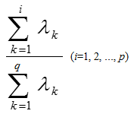
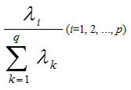

主成分分析
Principal Component Analysis (PCA) processes the data again, reduces the parameters and retains the original data information as much as possible.
Using formulas above to standardize the data, calculating the eigenvectors and total contribution rates of PCA. The first 14 principal components (whose contribution rate over 80%) were selected.
$$z_{1}=a_{11}x_{1}+a_{21}x_{2}+a_{31}x_{3}+a_{41}x_{4}+a_{51}x_{5}+…+a_{26 1}x_{26}$$
$$z_{2}=a_{12}x_{1}+a_{22}x_{2}+a_{32}x_{3}+a_{42}x_{4}+a_{52}x_{5}+…+a_{26 2}x_{26}$$
$$…$$
$$z_{14}=a_{1 14}x_{1}+a_{2 14}x_{2}+a_{3 14}x_{3}+a_{4 14}x_{4}+a_{5 14}x_{5}+…+a_{26 14}x_{26}$$

Slide 3
04
模型建立
定性结论与模型深度分析

Slide 4

权重确定方法
Target Layer (RAM)
P₁
P₂
P₃
Scheme Layer(Click Rate)
C₁
C₂
C₃
C₄
C₅
$$Aw=λw$$
Among phones with middle display resolution, both phones with higher click rate and lower click rate takes a large proportion.
线性回归
Click Rate | Convert Rate
0.115124 | 0.162528
KNN 算法

Slide 5
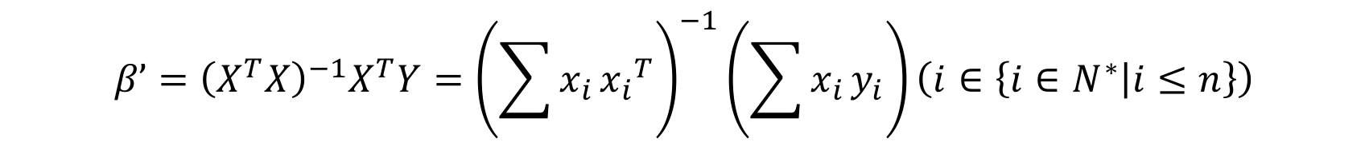

线性回归
$$y_{n}=β_{0}+β_{1}x_{1}+β_{2}x_{2}+β_{3}x_{3}+β_{4}x_{4}+β_{5}x_{5}+β_{6}x_{6}\left(n∈\left\{1,2\right\}\right)$$
$$β’={\left(X^{T}X\right)}^{−1}X^{T}Y={\left(\sum{x_{i}}{x_{i}}^{T}\right)}^{−1}\left(\sum{x_{i}}y_{i}\right)\left(i∈\left\{i∈N^{∗} | i≤n\right\}\right)$$
$$P\left\{{\hat{θ}}_{1}<θ<{\hat{θ}}_{2}\right\}=1−α$$
$$P\left\{{\hat{β}}_{n 1}<β<{\hat{β}}_{n 2}\right\}=1−α \left(n∈\left\{n∈N^{∗} | n≤2\right\}\right)$$

Slide 6
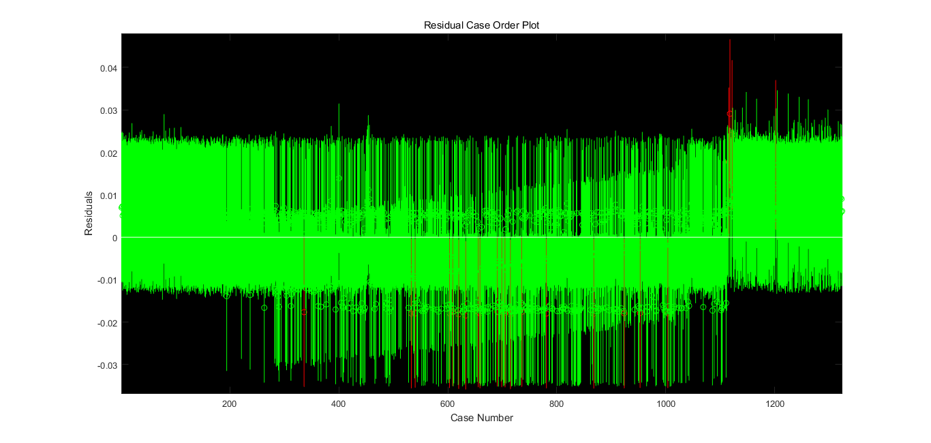
线性回归
Not much Outliers.

Slide 7
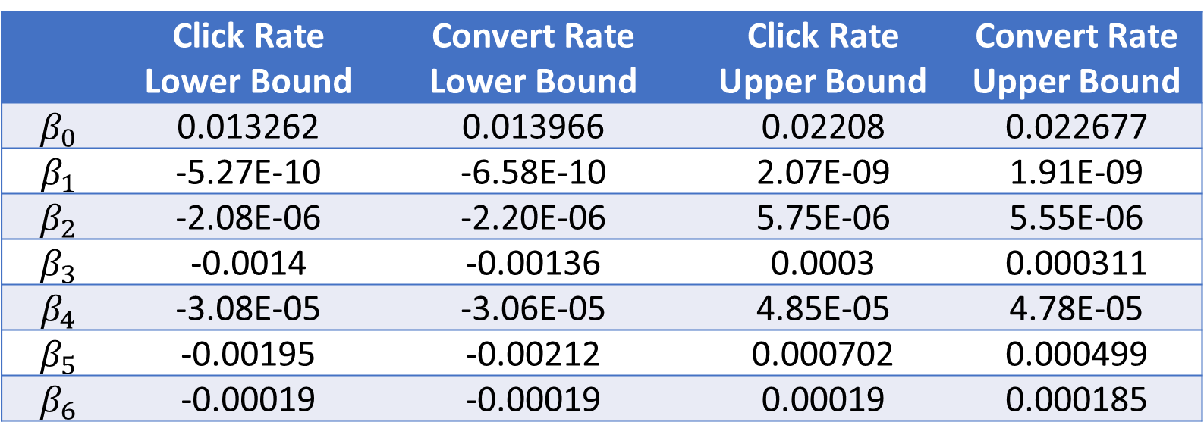
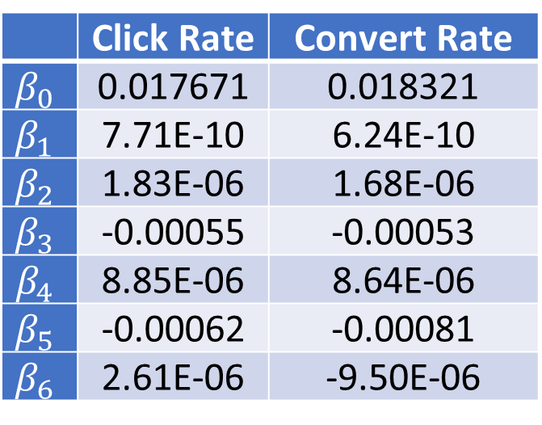
线性回归
 | Click Rate | Convert Rate
$$β_{0}$$ | 0.017671 | 0.018321
$$β_{1}$$ | 7.71E-10 | 6.24E-10
$$β_{2}$$ | 1.83E-06 | 1.68E-06
$$β_{3}$$ | -0.00055 | -0.00053
$$β_{4}$$ | 8.85E-06 | 8.64E-06
$$β_{5}$$ | -0.00062 | -0.00081
$$β_{6}$$ | 2.61E-06 | -9.50E-06
The low correlation coefficients in Linear Regression is insufficient to reveal the features of each variable precisely.
Click Rate | Convert Rate
0.115124 | 0.162528
 | Click Rate Lower Bound | Convert Rate Lower Bound | Click Rate Upper Bound | Convert Rate Upper Bound
$$β_{0}$$ | 0.013262 | 0.013966 | 0.02208 | 0.022677
$$β_{1}$$ | -5.27E-10 | -6.58E-10 | 2.07E-09 | 1.91E-09
$$β_{2}$$ | -2.08E-06 | -2.20E-06 | 5.75E-06 | 5.55E-06
$$β_{3}$$ | -0.0014 | -0.00136 | 0.0003 | 0.000311
$$β_{4}$$ | -3.08E-05 | -3.06E-05 | 4.85E-05 | 4.78E-05
$$β_{5}$$ | -0.00195 | -0.00212 | 0.000702 | 0.000499
$$β_{6}$$ | -0.00019 | -0.00019 | 0.00019 | 0.000185

Slide 8
05
模型优化
优化算法与模型定量结论

Slide 9
主成分回归
$${y_{n}}^{∗}=β_{1}′z_{1}+β_{2}′z_{2}+β_{3}′z_{3}+…+β_{14}′z_{14}\left(n∈\left\{n∈N^{∗} | n≤2\right\}\right)$$
$$y_{n}=β_{0}+β_{1}x_{1}+β_{2}x_{2}+β_{3}x_{3}+…+β_{26}x_{26}\left(n∈\left\{1,2\right\}\right)$$
Click Rate | Convert Rate
0.805032 | 0.826614

Slide 10
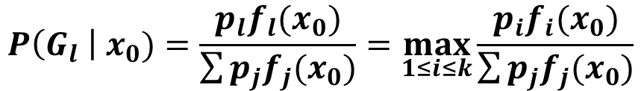
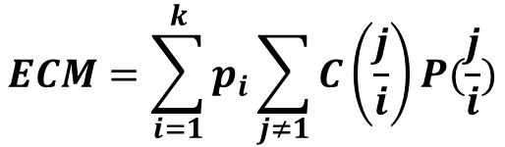
贝叶斯判别
 | High sales | Low sales
High display resolution | 7 | 1
Low display resolution | 3 | 9
$$P\left(G_{l} \right| x_{0})=\frac{p_{l}f_{l}(x_{0})}{\sum{p_{j}f_{j}(x_{0})}}=\max_{1≤i≤k}{\frac{p_{i}f_{i}(x_{0})}{\sum{p_{j}f_{j}(x_{0})}}}$$
$$ECM=\sum_{i=1}^{k}{p_{i}\sum_{j≠1}{C\left(\frac{j}{i}\right)P(\frac{j}{i})}}$$

Slide 11
贝叶斯判别
RAM to Click rate (the smaller the category is, the lower the click rate is)
 | Category 1 | Category 2 | Category 3 | Category 4
0.125 | 2 | 0 | 0 | 0
0.5 | 7 | 0 | 0 | 1
1 | 49 | 0 | 1 | 7
1.5 | 1 | 0 | 0 | 0
2 | 91 | 0 | 15 | 25
3 | 41 | 1 | 64 | 19
4 | 1 | 13 | 68 | 2
6 | 0 | 11 | 22 | 0
8 | 0 | 0 | 1 | 0
Phones with higher display resolution are apt to reveal more satisfactory sales condition. Phones with middle RAM may experience low sales or high sales.

Slide 12
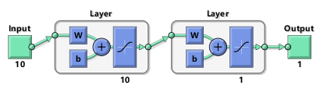
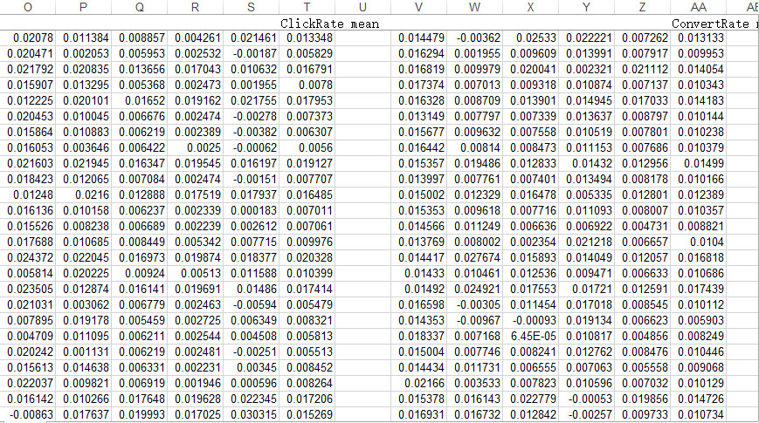
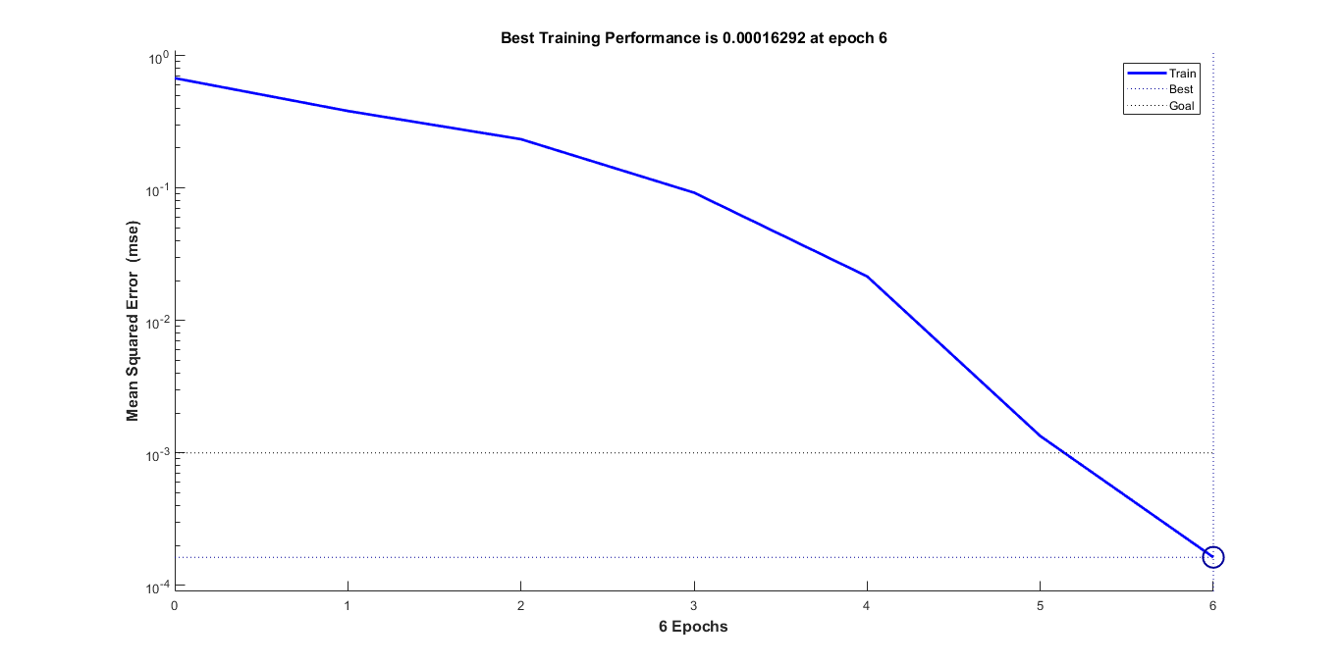
BP神经网络
Model with 10 layers do not consume too much time, while it has a better performance. The error is decreasing rapidly. The error of some data in the table lower than 1%.

Slide 13
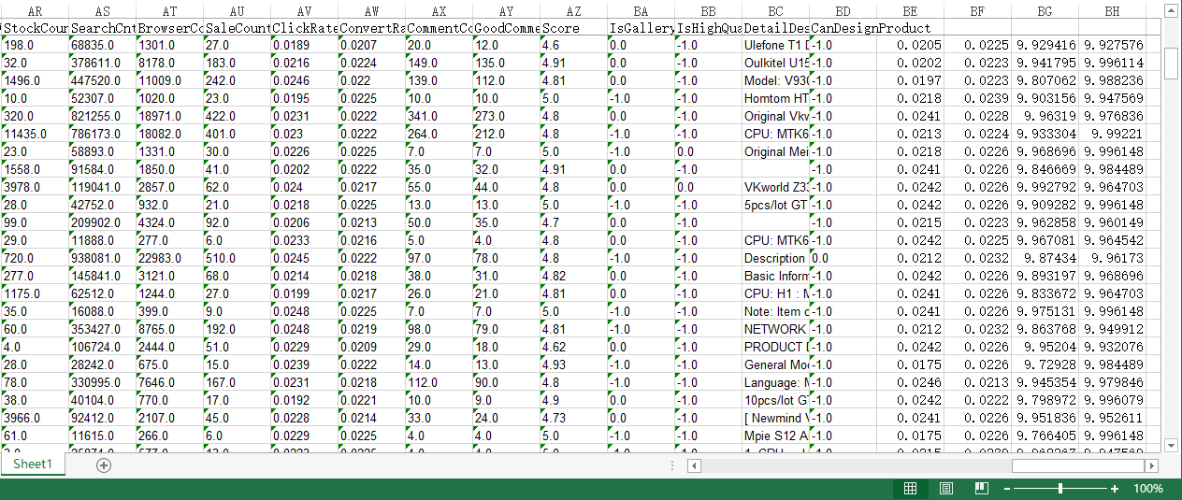
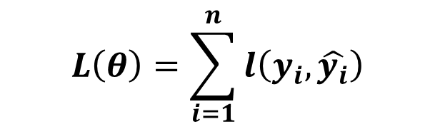
XGBoosting 算法
Age | Monthly shopping Amount | Usually asking or answering on Quora
14 | Less than 1000 yuan | Asking
16 | Less than 1000 yuan | Answering
24 | More than 1000 yuan | Asking
26 | More than 1000 yuan | Answering
$$L\left(θ\right)=\sum_{i=1}^{n}{l\left(y_{i},\hat{y_{i}}\right)}$$
Combining several weak classifier into a strong classifier through minimizing loss function and error.

Slide 14
感谢倾听
以下是提问环节
曹凌微 钱成 田肇阳
清华大学附属中学
指导教师：吴昊 王殿军

